Slide 1


Technical workshop for GCF project: Climate change and climate change impacts on São Tomé and Príncipe with a focus on fishery and tourism sectors in a Blue Economy context Sao Tome and Principe, November/December 2025
Tools for climate and sectoral risk analyses
By: Riccardo Soldan
Link to all materials: https://github.com/Risk-Team/trainings/tree/main/STP

Slide 2
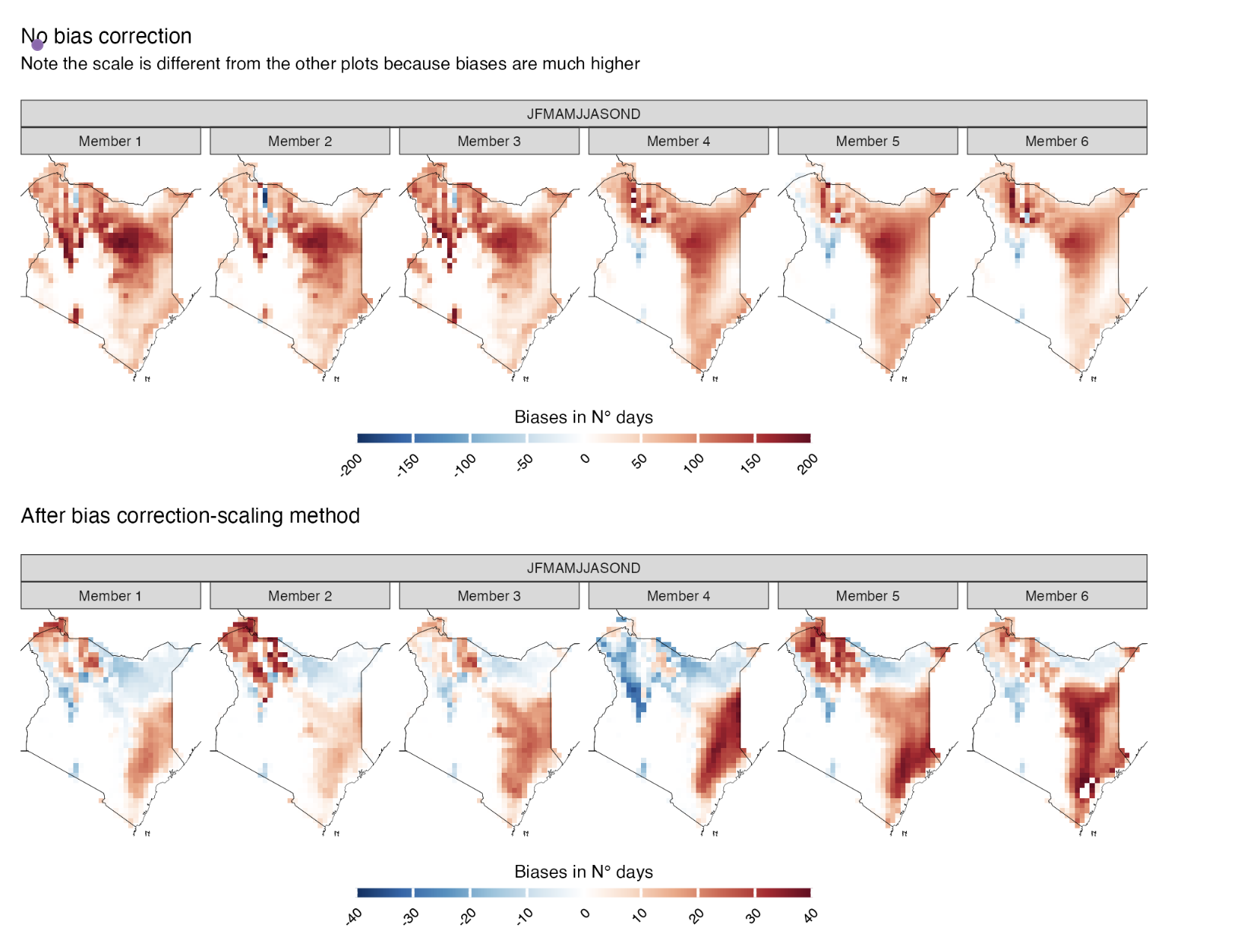
How do we get to this output?

Slide 3
How do we get the climate data from
Earth System Grid Federation (ESGF)
Copernicus Climate Data Store (CDS)

Slide 4
What do we need to know to analyse climate data
Environments
Programming
Specific libraries
cdo (Climate Data Operator)
Xarray
Xclim
Climate4R

Slide 5
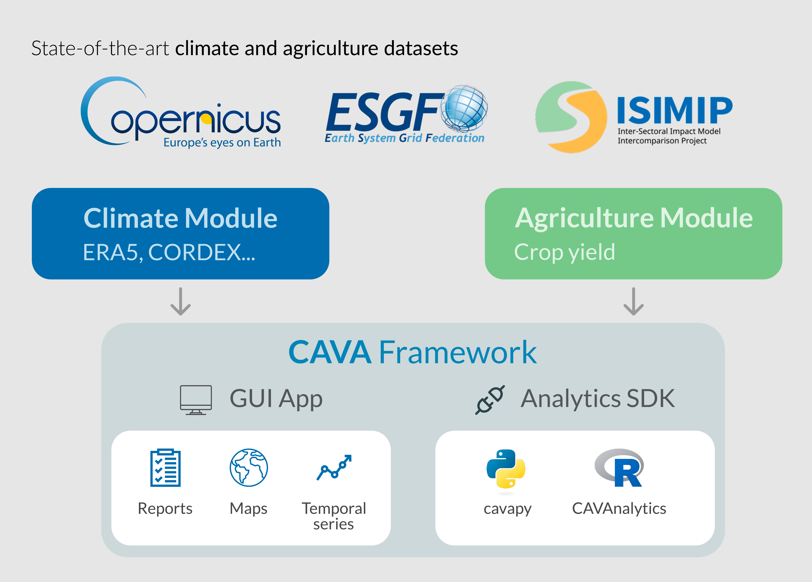
Climate and Agriculture Risk Visualization and Assessment (CAVA)

Slide 6
Riccardo Soldan
Riccardo.soldan@fao.org
Samuel Greenrod
Samuel.greenrod@fao.org
Thank you!

